Slide 1
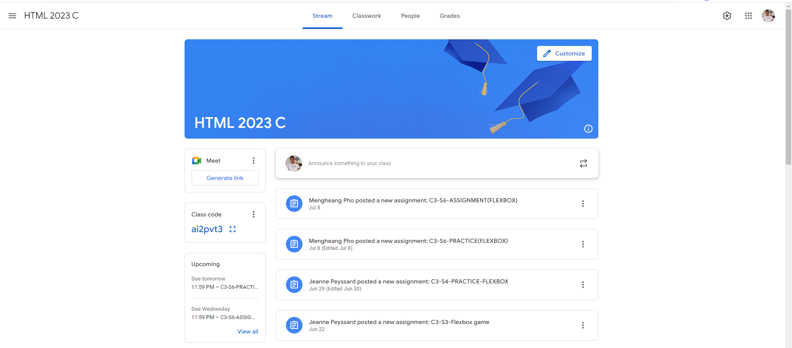
Identify root components of website below

Slide 2
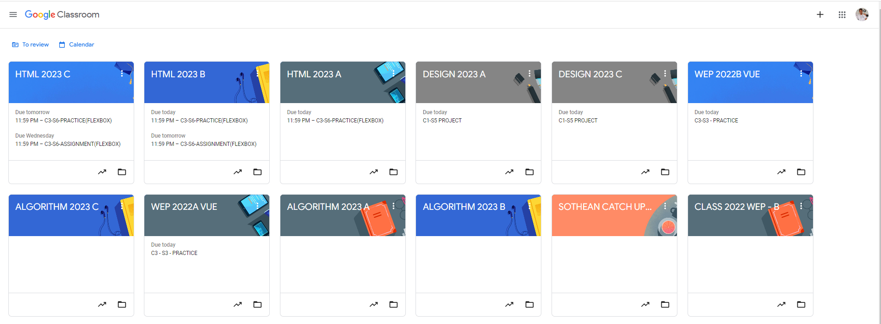
Root div
- Height: 100vh
content
nav
Flex: 0
header
Flex: 0
Flex: 1

Slide 3
Identify root components of website below
Navigation
Header
Side-Content
Main-Content

Slide 4
Identify root components of website below
Navigation
Header
Side content
Main Content
Main Content
Side content
Main Content
Side content
Main Content
Main Content

Slide 5

In navigation area:
Nav-left
Nav-center
Nav-right
FLEX: 0
FLEX: 1
FLEX: 0
Flex-direction: row
In header area:
FLEX: 0
FLEX: 0
Header-left
Header-right
Flex-direction: row

Slide 6
Side-Content area:
FLEX: 0
FLEX: 0
Flex-direction: column
FLEX: 1

Slide 7
Main-Content area:
Flex-direction: column

